Slide 1

Intellisense in a web based Integrated development environment

Slide 2
For Assess Machines
Amit Kriplani
Barna Bhattacharya
TA Mentor
- Rohit SVK

Slide 3
Team on Project
Syed Juned Ali
Lashit Jain
Raj Manvar
Shalin Agrawal
Shivang Nagaria

Slide 4
Agenda
Overview
What is the project , how does it help ?
Features
How does it help the users ?
Resources
Where to get more information about the application

Slide 5
What is an IDE?
An IDE i.e Integrated development environment is a software application that helps a software programmer to build software applications by providing comprehensive tools and features.
An IDE normally consists of a source code editor,build automation tools and a debugger.
Modern IDE's provide with a great helpful functionality of intelligent code completion.
Examples – Eclipse , Netbeans

Slide 6
Intellisense
Intellisense which is intelligent code completion is the main focus of our IDE.
We are using intellisense in our IDE to apply it in recruitment of candidates
The IDE will make a really programming friendly environment , mainly focusing on logic and voiding the syntactical dependence
Intellisense will be extended to many languages like C, C++, Java and C#.
This recruitment procedure will save time.

Slide 7
Features of Intellisense
Auto-completion of function names
Scope variable detection
Variable highlighting
Code snippets
Extracting all the related functions of a particular class
Major Advantages
Syntactical independence
More emphasis on logic rather than code
Learning more about the code
Time saving , less key presses

Slide 8
Advantages of intellisense from the project point of view
Help in the interview process by assisting the interviewee
Logic based selection
No need to be thorough with the libraries and common functions of the language

Slide 9
How does it work?
The interviewee logs in and is redirected to the editor page.
The interviewee types the name of a function
A list of functions related to the input drops down via a Ajax call to the database of the application.
The list contains the name , signature , return type and the argument types of a function.
Even the local variables are cached and when a user types the prefix of a local variable a drop down list comes up having the names of all local variables having the same prefix.
This list is then rendered into our base editor and is available to interviewee as intellisense data.

Slide 10




The Big Picture
User logs in to use IDE
All local variables are stored in cache for scope variable detection
Ajax call from the IDE gives the required data
Local variables are passed to the IDE via Ajax call
All the library functions are passed to the IDE via Ajax

Slide 11



User profile
Interviewee
Interviewer
Admin

Slide 12
Interviewee
Candidate for a job interview.
Can view the questions provided by the interviewer.
Can select the language specified by the interviewer.
Can code the solution in the selected language using the IDE with the intellisense features.

Slide 13
Interviewer
Can be the any representative of a company or any organization.
Can set the questions for the interviewee
Can put restrictions on the language usage by the interviewee
Can see the results of all the interviewee

Slide 14
Admin
Is manager of the IDE.
Maintains the IDE and the intellisense data.
Acts as a bridge between interviewer and interviewee.

Slide 15
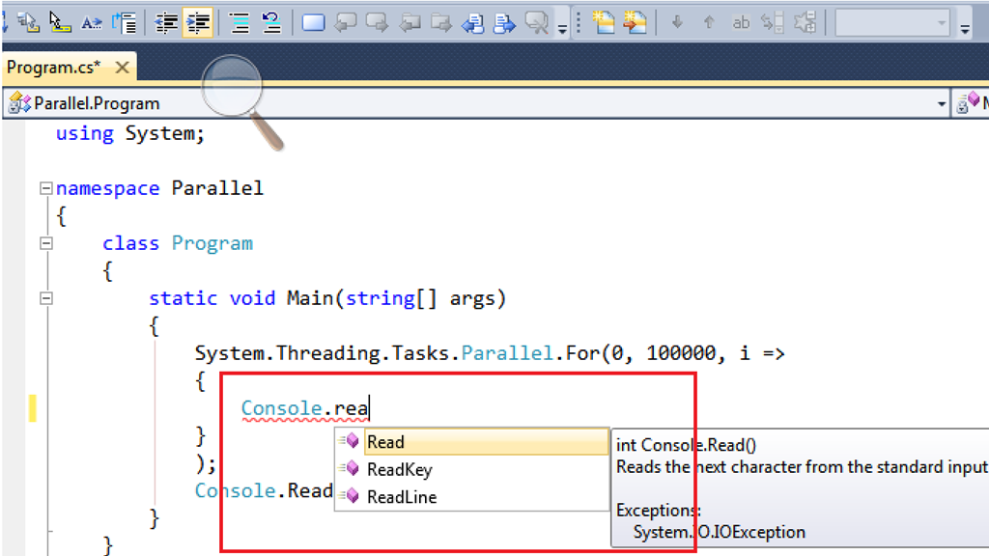
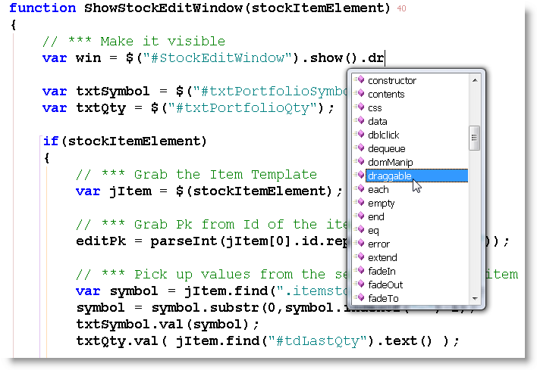
Pictorial representation of Intellisense
Extracting Functions
Class “Console” has the Read , Readline , Readkey as functions which pop down as a list when we just type prefix “rea”
A list of all the related functions of the class “#StockEditWindow.show()” are listed down via intellisense.
This way Intellisense not only saves time but also helps us not remembering the exact syntax or function name.

Slide 16
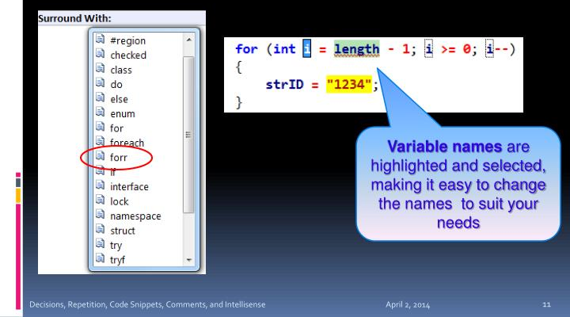
Pictorial representation of Intellisense
Caching and highlighting of local variables

Slide 17
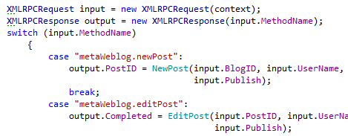
Pictorial representation of Intellisense
Syntax highlighting
The Syntax Highlighting feature allows you to easily distinguish between local variables and fields in your code.

Slide 18
Future Prospects
The IDE has more potential to be enhanced , improved and added with varied functionalities.
Improved cache based storage
Code snippets
Improved intellisense with library dependent data retrieval , reducing the irrelevant suggestions.

Slide 19
Resources
To know more about assessmachines
www.assessmachines.com
To know more about intellisense visit
www.en.wikipedia.org/wiki/Intelligent_code_completion

